Slide 1
12 Ways to Cook Pizza on a Campout
Terry McKibben
Assistant Scoutmaster
BSA Troop 344/9344
Pemberville, OH
troop344leaders@gmail.com

Slide 2
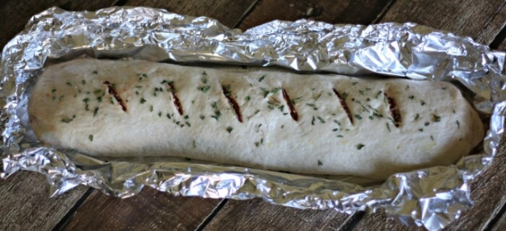
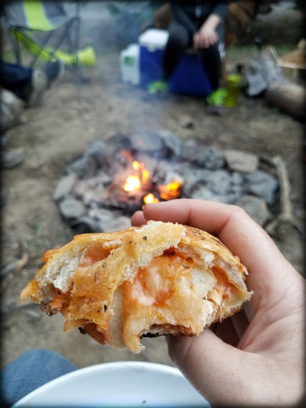
Campfire Pizza Logs
Make a Campfire Pizza Log.
Nothing beats fresh, piping hot pizza after a fun-filled day of playing outdoors!

Slide 3
Campfire Pizza Logs
Ingredients:
Refrigerated pizza dough (the kind you roll out from a can)
1 cup pizza sauce
1 cup shredded cheese
½ cup favorite toppings - pepperoni slices, cooked chicken, ham or bacon, peppers, mushrooms (Don’t go overboard on toppings as this gets rolled)
2 tbsp. melted butter
A good sprinkle of herbs and spices - oregano basil, garlic, salt, etc. for the top

Slide 4
Campfire Pizza Logs
Make the Pizza Log:
Roll out pizza dough to form a rectangle.
Spread pizza sauce over top.
Top with cheese and additional toppings.
Tip: Be careful not to overstuff as the more toppings you make the longer it will take to bake/cook
Roll pizza up to form a log and tuck edges in.
Take a large piece of thick aluminum foil (about the size of a sheet pan, and spray lightly with nonstick spray)
Carefully transfer the log onto the foil, then brush the log with melted butter and sprinkle with herbs before wrapping in the foil.
Then wrap in a second layer of foil (in case outer layer tears while turning).

Slide 5
Campfire Pizza Logs
Cook the Pizza Log:
GRILL: You can grill this around 350-400, for about 25-30 mins
OVEN: Preheat the oven to 400 and bake for about 20-25 minutes or until the dough is golden. **ALL OVEN TEMPS VARY, it may need more time!
CAMPFIRE: Let your fire ease up until you have about 1 inch of hot coals. Place the log onto the coals and let cook about 25-30 mins, turning occasionally. **BE sure you have SUPER thick foil if this is going on a campfire!
Be VERY careful when you open the foil as STEAM BURNS. If it needs a few more minutes you can let it bake longer. You want the dough to turn into a crust.

Slide 6
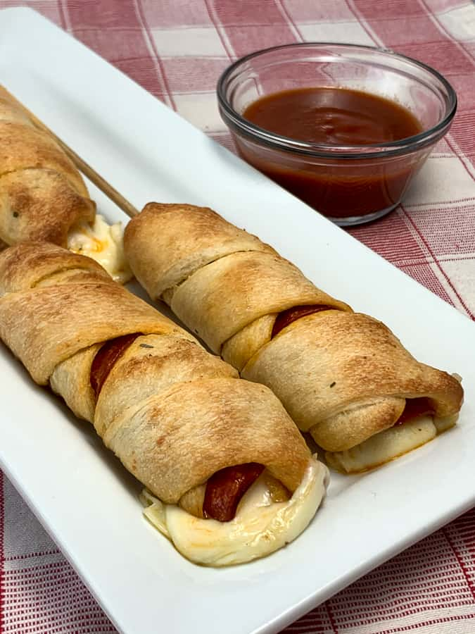
Campfire Pizza on a Stick
A favorite of many scouts, campfire pizza on a stick is simple and fun to do.

Slide 7
Campfire Pizza on a Stick
Ingredients:
1 tube of refrigerated pizza crust dough
1/2 cup thin-slice pepperoni
8 cheese snack sticks (Mozzarella recommended, but go with your favorite)
1 small jar of your favorite pizza sauce
Equipment:
1 cooking stick for each "cook"
4 wooden skewers
1 small pot

Slide 8
Campfire Pizza on a Stick
Instructions:
Pour about half the pizza sauce into the pot and set it off to the side of the campfire or on the side of the grill to begin warming slowly without burning.
Slice the cheese snack sticks into 1-inch-long sections.
Alternating between cheese and doubled, folded pepperoni, press those ingredients onto a skewer until they tightly span a 12-inch length.
Press out the refrigerated pizza crust dough into a 9x12-inch rectangle. Cut into four 2.25x12-inch strips.

Slide 9
Campfire Pizza on a Stick
Instructions (continued):
Holding the skewered cheese and meat along the end of the cooking stick, wrap both the skewered food and the cooking stick tightly in one strip of the dough.
Repeat for each of the skewers and cooking sticks.
Hold the rolled pizza at least eight inches above coals or flame, rotating slowly until all sides are golden brown
Slide off the cooking stick. Pull out the skewer. Dip in the heated pizza sauce and enjoy.

Slide 10
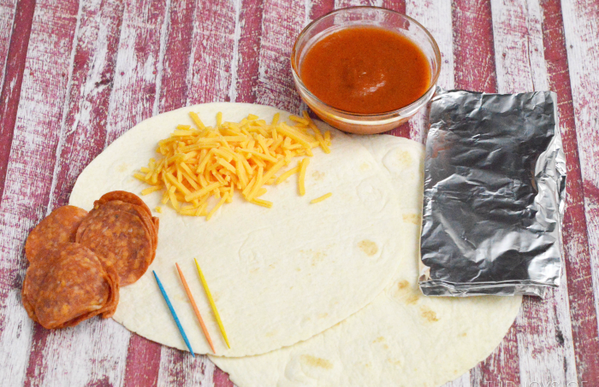
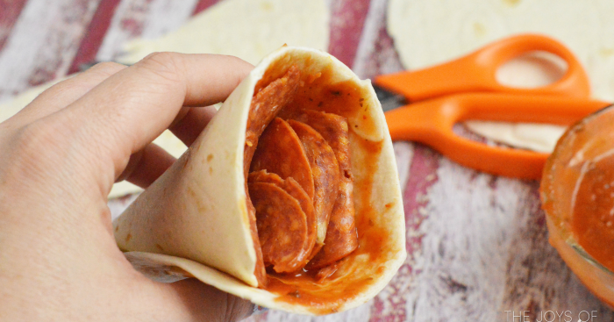
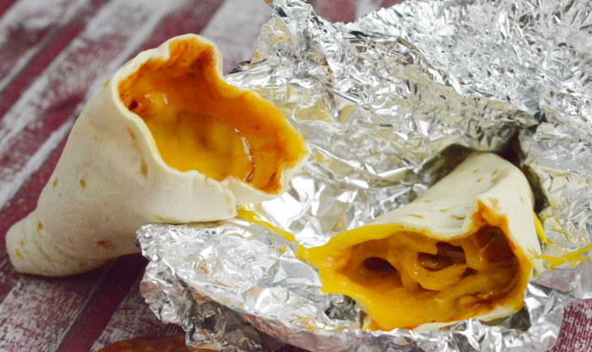
Campfire Pizza Cone
Pizza in a cone? Most people love to eat food on a stick because it’s fun. Even more love to eat ice cream in a cone because it’s more fun. Now you can turn your pizza in to a cone. Who wouldn’t love this.
Scouts will think this is a cool thing to do. Pizza cones are a way to make one of your favorite meals even more fun and portable.

Slide 11
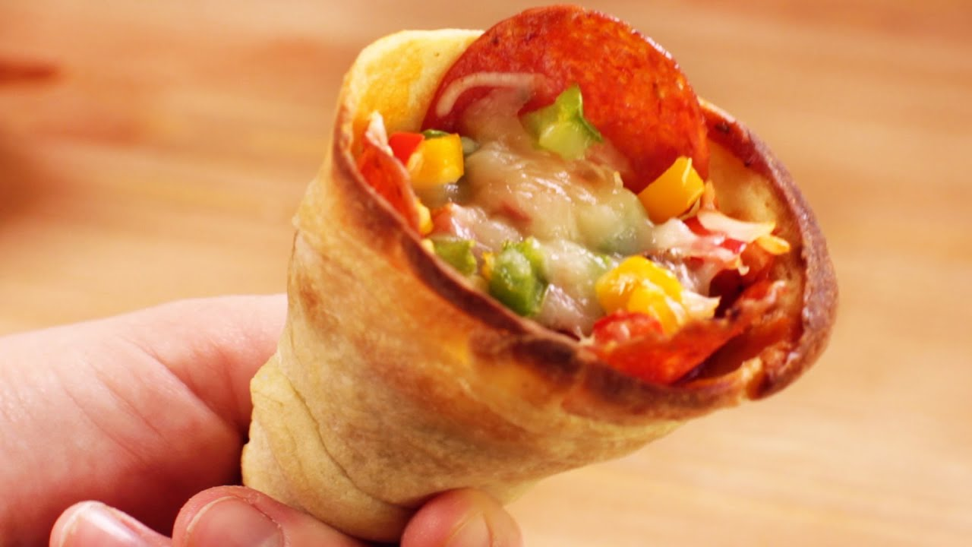
Campfire Pizza Cone
Ingredients:
Tortillas
Pepperoni slices
Pizza sauce
Shredded cheese (mozzarella or cheddar)
Additional toppings of your choice.

Slide 12
Campfire Pizza Cone
Instructions:
Take your tortilla and wrap it into a cone shape. Make sure there is no hole in the bottom of the cone. Once wrapped, place a toothpick in it to hold it in place.
Trim excess tortilla with scissors or any cutting utensil you have on hand.
In the bottom of your cone, place one or two slices of pepperoni. This will help seal it even further.
Put a layer of shredded cheese. We used mild cheddar but mozzarella would be good too.
Put your sauce on top of the cheese and spread it around the cone if desired.

Slide 13
Campfire Pizza Cone
Instructions (continued):
Put a layer of pepperoni on top of the cheese and sauce.
Put another small layer of cheese to seal all the ingredients in.
Wrap your cone in tinfoil take care not to smash in the top too far.
Place in the fire sitting upright if possible. Cook 5-7 minutes depending on the heat of your fire.
Unwrap and enjoy!

Slide 14
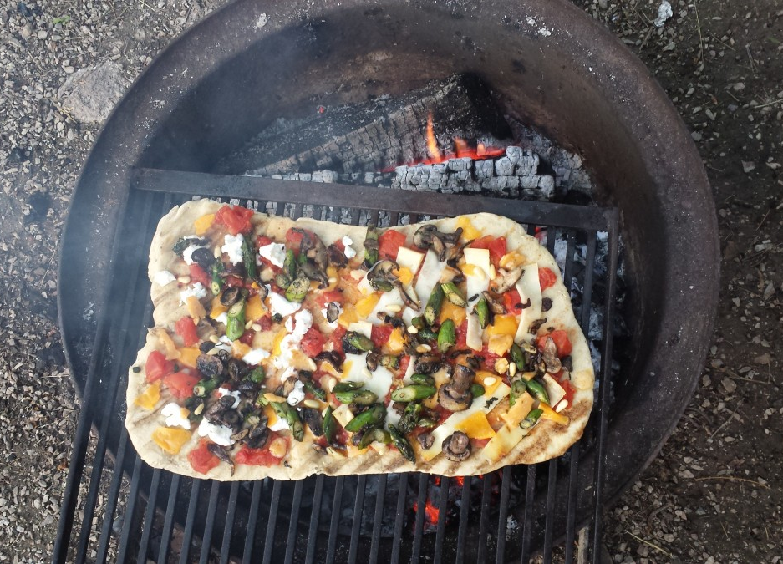
Pizza on a Grill
This one is most like traditional pizza making, but it does require you have a grill apparatus.
Check to see if your campsite has a grill, or bring one with you.

Slide 15
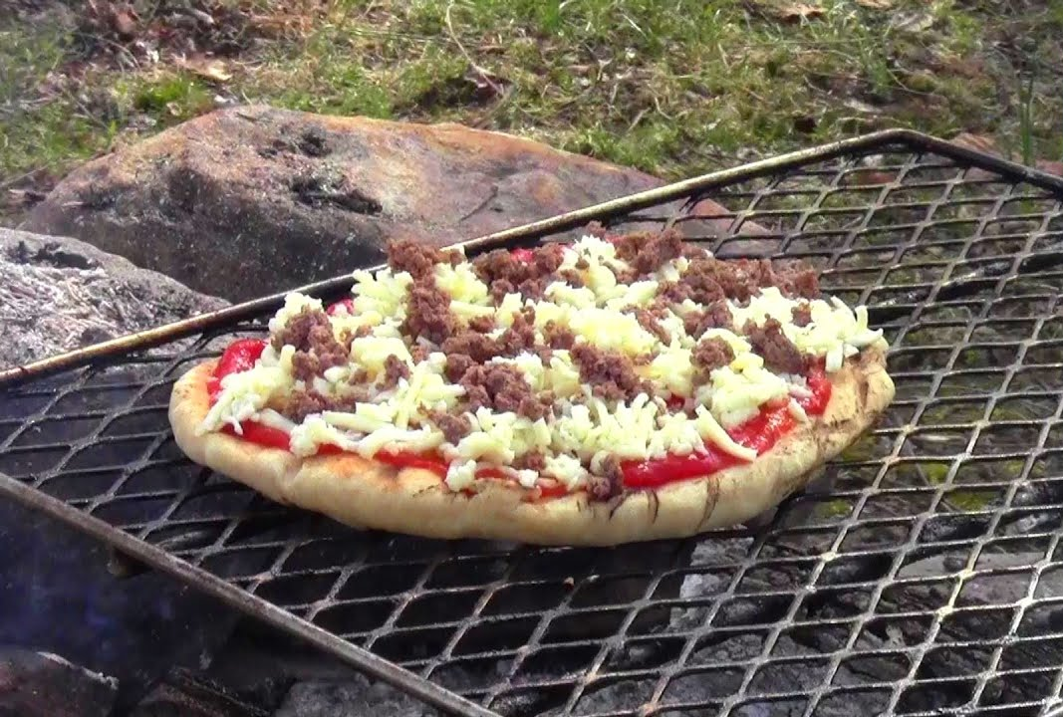
Pizza on a Grill
Ingredients:
1 tube of refrigerated pizza dough or frozen pizza dough
1 jar of pizza sauce
2 cups of mozzarella cheese
Your choice of pepperoni, mushrooms, vegetables, whatever toppings you want!

Slide 16
Pizza on a Grill
Instructions:
With this method, grill one side of the dough.
Remove from the fire and flip the crust.
Brush with pizza sauce, place your toppings on and then cover in cheese.
Return to the heat and cook until the crust is done underneath and the toppings are warm
You can even grill both sides if you are making extra thick dough before adding toppings.

Slide 17
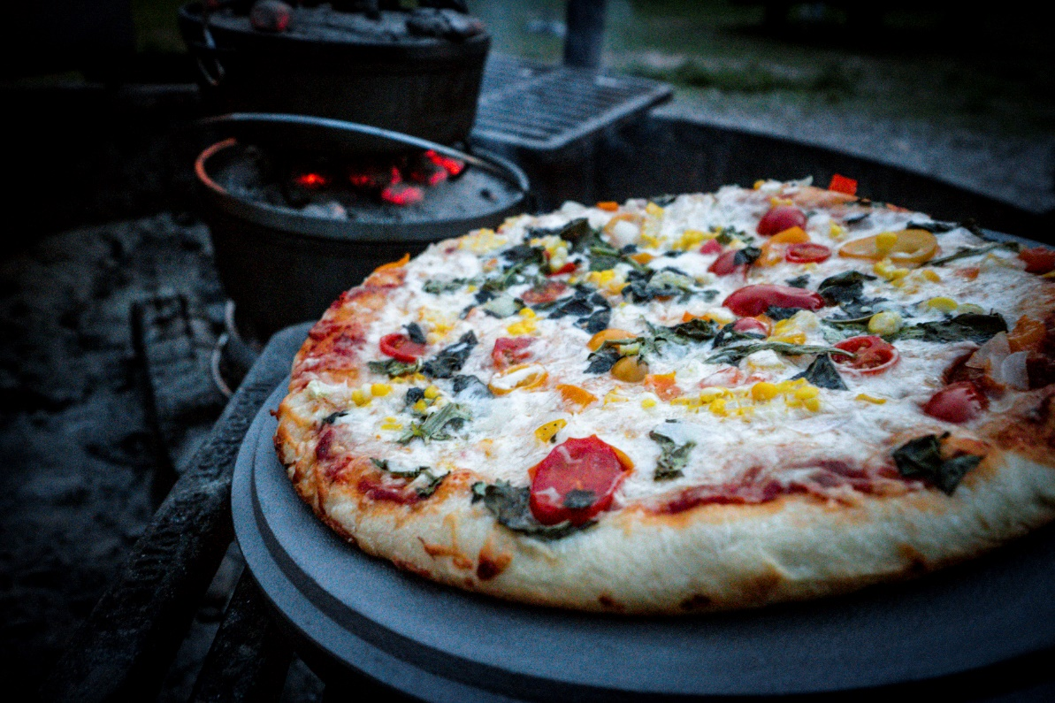
Pizza in a Dutch Oven
Pizza in the morning, pizza in the evening, pizza at supper time. When you know how to make pizza in a Dutch oven, you can have pizza anytime – and anywhere!

Slide 18
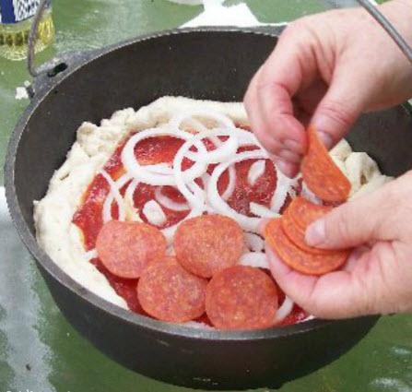
Pizza in a Dutch Oven
Ingredients:
Refrigerated pizza dough.
Pizza sauce.
Shredded mozzarella cheese.
Your favorite toppings.

Slide 19
Pizza in a Dutch Oven
Instructions:
Prepare charcoal for your Dutch oven.
Spray the inside of the Dutch oven with cooking spray or use a Dutch oven liner.
Roll out the pizza dough and press into the bottom of the Dutch oven leaving a little lip around the edge.
Spread the desired amount of pizza sauce on the dough.
Sprinkle the desired amount of cheese on the sauce.

Slide 20
Pizza in a Dutch Oven
Instructions (continued):
Top with your favorite toppings.
Place the lid on the Dutch oven.
Arrange prepared charcoal in a small circle and place the Dutch oven on top.
Arrange the remaining charcoal on the lid of the Dutch oven.
Bake for 20-35 minutes or until crust is desired crispiness.

Slide 21
Pizza in a Pie Pan Dutch Oven
Backpacking requires a balance of usefulness and lightweight for effective equipment.
Cast iron Dutch ovens are considered more attune to base camping or when you have a pack animal.
A lightweight backpacking alternative is the use of pie pans.

Slide 22
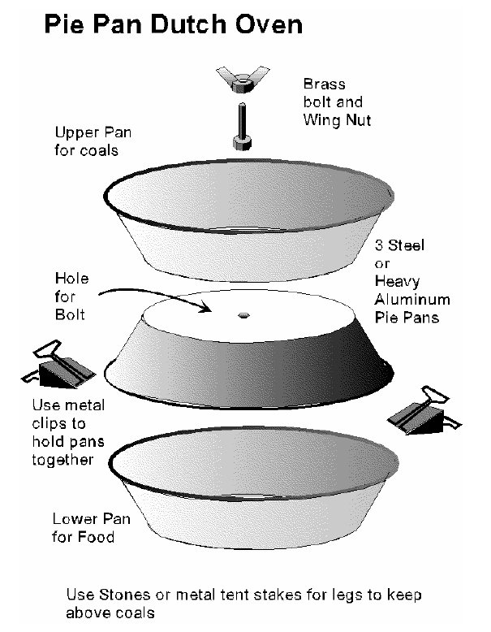
Pizza in a Pie Pan Dutch Oven
Use (3) 9 inch heavy duty aluminum pie pans. (Steel pie pans can rust.)
Two of the pans have a hole drilled through them with a brass or stainless steel bolt, 2 washers, and a wing nut to hold them together.
The diagram shows the basic setup.
The pans are supported above the coals by using rocks, tent stakes, or 3 long nails.
The outside of the pie pans can be painted black with automotive engine block paint.

Slide 23
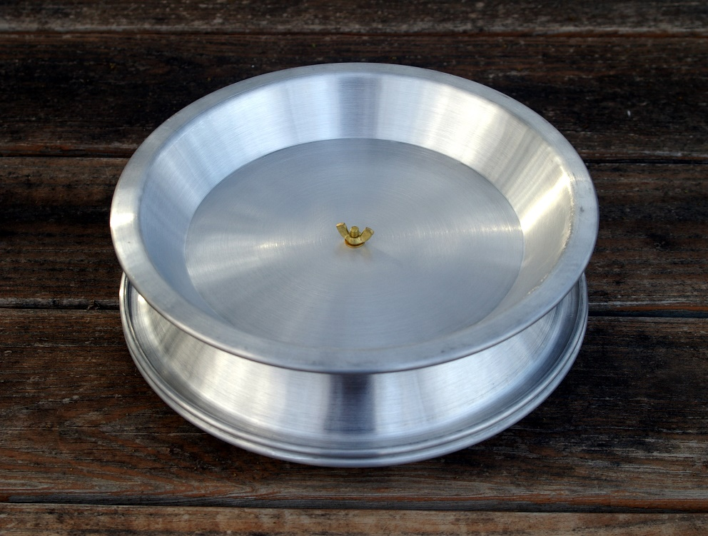
Pizza in a Pie Pan Dutch Oven
Pizza is made the same way as in a regular Dutch oven.

Slide 24
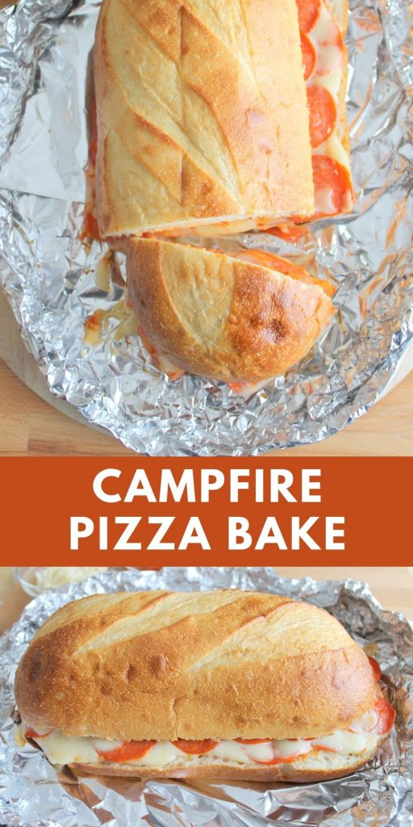
Pizza Sub in Foil
They are easy to make, and hard to do wrong.
They basically just need to warm enough to melt the cheese, but if you want them toasty just get them closer to the fire or leave them there longer.

Slide 25
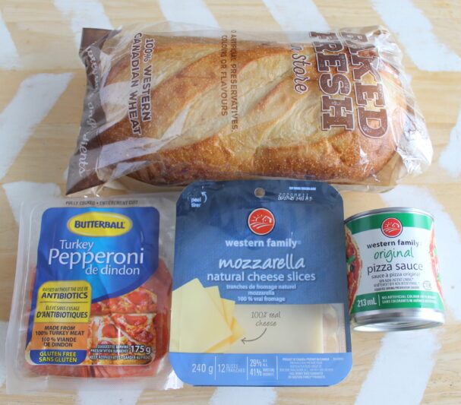
Pizza Sub in Foil
Ingredients:
1 loaf of French bread
1/2 can (100ml) of pizza sauce
150 g pepperoni, sliced
9 slices (60g) mozzarella cheese
Aluminum foil

Slide 26
Pizza Sub in Foil
Instructions:
Cut the French bread in half lengthwise.
Spread pizza sauce on both sides of the bread.
Layer pepperoni and cheese alternatingly on the bread.
Sandwich the ingredients between the two sides of the bread and wrap in aluminum foil.
Place over the campfire or barbeque for 15 mins or until warmed through and melted.
Cut into sandwich sized servings.

Slide 27
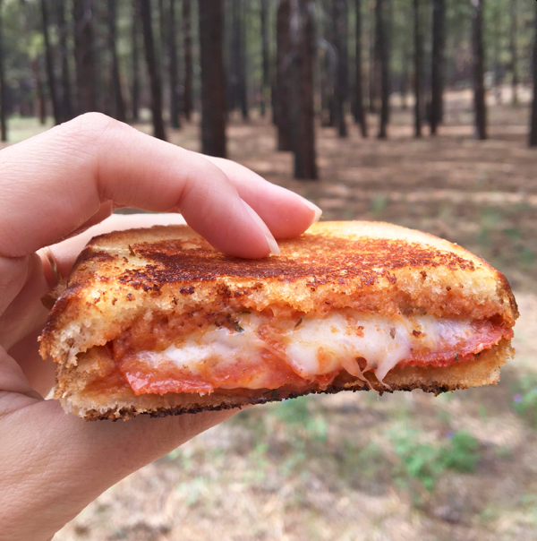
Pie Iron Pizza
You’ll need hot coals for pie iron pizzas, so start your fire a little early.
You’ll want it to have time to burn down a little bit, leaving behind nice toasty coals.

Slide 28
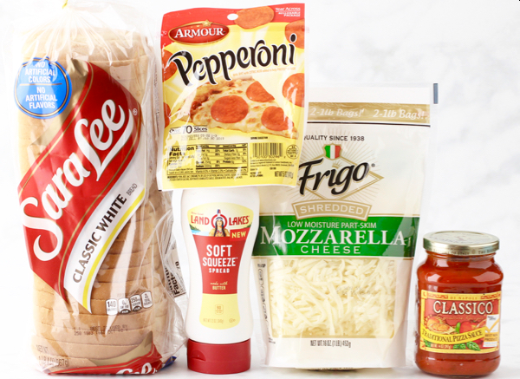
Pie Iron Pizza
Ingredients:
2 slices White Bread or Pizza Dough
1/4 cup Shredded Mozzarella Cheese
1/4 cup Pizza Sauce
6 Pepperoni Slices
Spreadable Butter
Optional Oregano

Slide 29
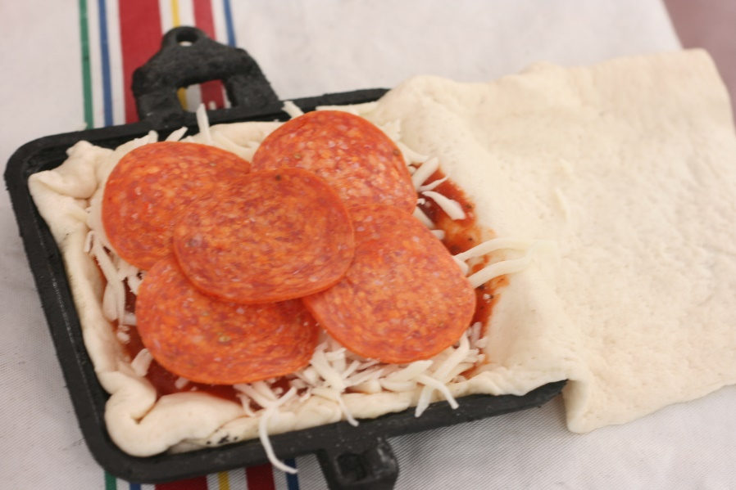
Pie Iron Pizza
Instructions:
Spray your pie irons with cooking spray.
Line one side with your chosen dough, whether that’s a piece of buttered bread or pizza dough cut to shape (If using dough, cut it into one long rectangular shape which you’ll fold over to create a pocket).
Fill with your sauce and toppings!

Slide 30
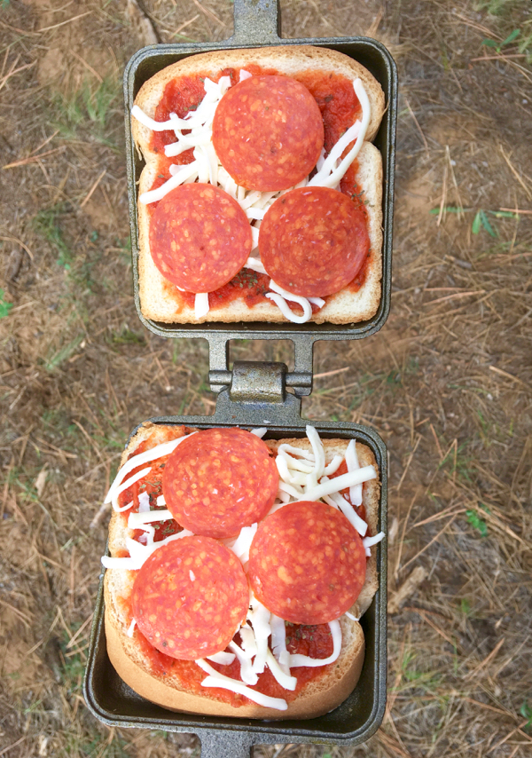
Pie Iron Pizza
Instructions (continued):
Top with another piece of buttered bread or fold the dough over the top of your ingredients. If you’re working with dough, pinch the sides closed.
Close up campfire pie iron, and cook over hot coals for 1 minute - 1 minute 30 seconds on each side (2 - 3 minutes total). Check to see if done.
Once done, carefully open up pie iron, remove your pizza pie, transfer to a plate, and ENJOY!
They’ll be very hot! Let them cool!

Slide 31
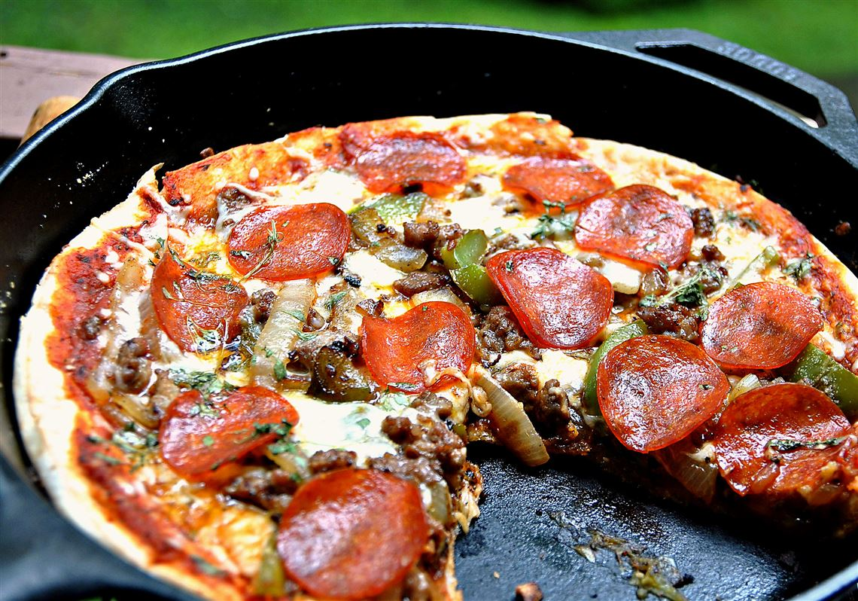
Cast Iron Pan Pizza
Another common method that's similar to the Dutch oven, but is going to be lighter and take up less space, is using a cast iron skillet.

Slide 32
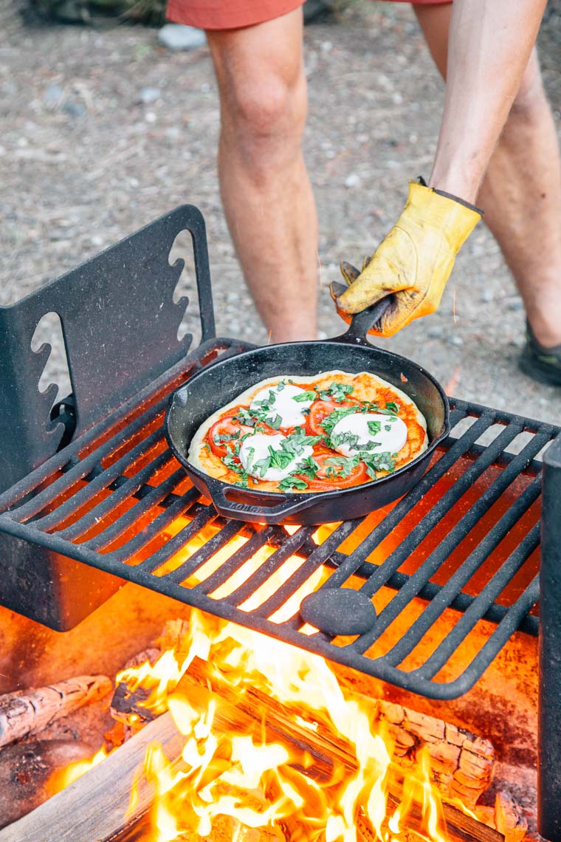
Cast Iron Pan Pizza
Ingredients:
1 tube of refrigerated pizza dough or frozen pizza dough
1 jar of pizza sauce
2 cups of mozzarella cheese
Your choice of pepperoni mushrooms, vegetables, or whatever toppings you want!

Slide 33
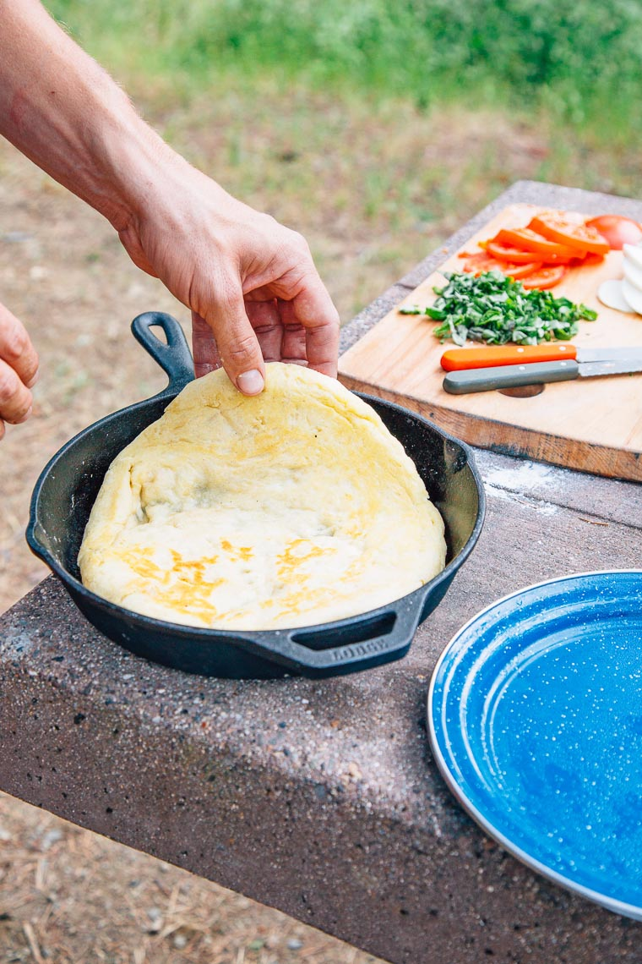
Cast Iron Pan Pizza
Instructions:
Oil a cast iron pan ( or baking sheet, pizza stone etc.)
Take the refrigerated dough and spread in the pan.
Place on the fire or the BBQ. Cook until the bottom has browned. Remove from the fire and flip the crust in the pan.
The key to making campfire pan pizza is that you have to cook the crust first, flip it in the pan, then add your sauce and toppings.
There is nothing worse than gluey, under cooked pizza dough and this method is how you prevent it!

Slide 34
Cast Iron Pan Pizza
Instructions (continued):
Apply pizza sauce, place your toppings on and then cover in cheese.
Return to the heat and cook until the crust is done underneath and the toppings are warm.
Remove and enjoy!
Caution, a lot of folks burn their pizza dough in this process. Don’t put your pan on direct heat for too long. Maybe keep it there long enough to get things started, then either place on a raised platform or move to the side and turn occasionally.
Optional: Cover your cast iron pan with a cast iron lid if you have one, or cover in foil to trap in heat (but don’t put coals on top).

Slide 35
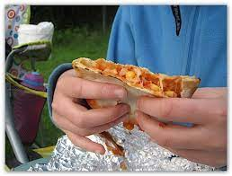
Pocket Pizzas
It is important to note that the pizzas aren’t cooked as such (they are toasted), and so any fillings you choose should be items that are safe to eat raw (i.e. use cooked meats if you want that in your topping).

Slide 36
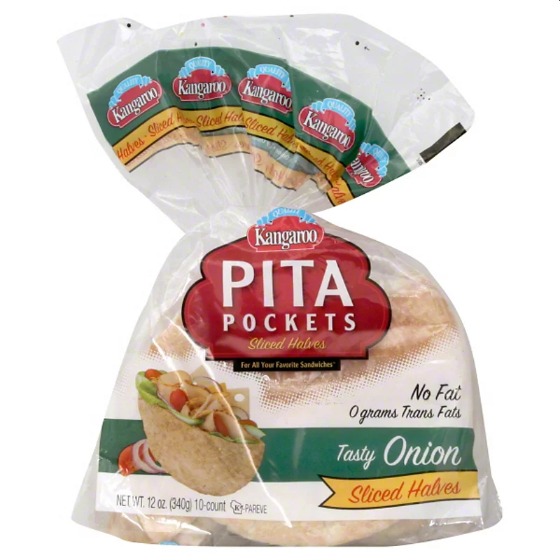
Pocket Pizzas
Ingredients:
A packet of pita bread
1 can or jar of pizza sauce
Mozzarella cheese
Your choice of pepperoni, mushrooms, vegetables, or whatever toppings you want!

Slide 37
Pocket Pizzas
Instructions:
Cut each pita bread in half, creating a pocket.
Add a spoon of pizza sauce, spreading it evenly around the pocket.
Add the mozzarella cheese and any other fillings.
Wrap in foil.

Slide 38
Pocket Pizzas
Instructions (continued):
Place the wrapped pocket over the hot coals of a campfire, or suspended above the fire. Depending on the heat of the fire, you may need two minutes on each side of the pizza. Try the first pizza for a minute and then unwrap to see how well it is doing and judge for yourself.
The result should be a pita bread that’s not burnt, with the sauce heated through and the cheese melted. If you find your pita bread sticking to the foil then you may want to use cooking spray on the foil first and place a it bit further away from the heat.

Slide 39
DIY Brick Pizza Oven
Learn how to build a simple wood fired brick pizza oven.
It takes about an hour to build the wood fired pizza oven in your backyard.

Slide 40
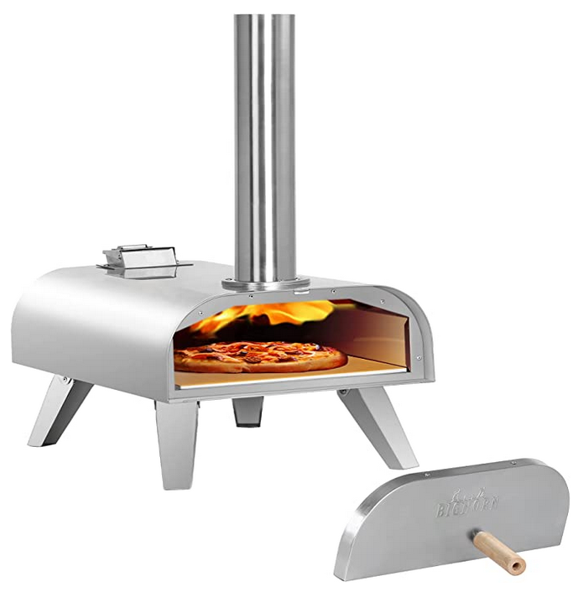
Wood Pellet Pizza Oven
Add wood pellets and preheat for approximately 18 minutes, once it reaches the desired temperature you're ready to bake.
Bake delicious pizzas in as little as 1 to 2 minutes.
You need to take the pizza out of the oven to turn it every 15 seconds or so or it will burn.

